Slide 1
Data Objects and Attribute Types_1
CSE402A
Data Mining
B. Tech. CSE, 2017
Course Leader:
Mohan Kumar K N
mohan.cs.et@msruas.ac.in

Slide 2
Objectives
At the end of this lecture, student will be able to
Describe types of data sets, characteristics of structured data
Describe the basic statistical descriptions of data
Understand correlated and uncorrelated data

Slide 3
Outline
Types of Data Sets
Characteristics of Structured Data
Data Objects
Attribute and its Types
Basic Statistical Descriptions of Data
Measuring the Central Tendency
Uncorrelated Data
Summary

Slide 4
Types of Data Sets
Record
Relational records
Data matrix, e.g., numerical matrix, crosstabs
Document data: text documents: term-frequency vector
Transaction data
Graph and network
World Wide Web
Social or information networks
Molecular Structures
Ordered
Video data: sequence of images
Temporal data: time-series
Sequential Data: transaction sequences
Genetic sequence data
Spatial, image and multimedia:
Spatial data: maps
Image data:
Video data:

Slide 5
Important Characteristics of Structured Data
Dimensionality
Curse of dimensionality
Sparsity
Only presence counts
Resolution
Patterns depend on the scale
Distribution
Centrality and dispersion

Slide 6
Data Objects
Data sets are made up of data objects.
A data object represents an entity.
Examples:
sales database: customers, store items, sales
medical database: patients, treatments
university database: students, professors, courses
Also called samples , examples, instances, data points, objects, tuples.
Data objects are described by attributes.
Database rows -> data objects; columns ->attributes.

Slide 7
Attributes
Attribute (or dimensions, features, variables): a data field, representing a characteristic or feature of a data object.
E.g., customer _ID, name, address
Types:
Nominal
Binary
Numeric: quantitative
Interval-scaled
Ratio-scaled

Slide 8
Attribute Types
Nominal: categories, states, or “names of things”
Hair_color = {auburn, black, blond, brown, grey, red, white}
marital status, occupation, ID numbers, zip codes
Binary
Nominal attribute with only 2 states (0 and 1)
Symmetric binary: both outcomes equally important
e.g., gender
Asymmetric binary: outcomes not equally important.
e.g., medical test (positive vs. negative)
Convention: assign 1 to most important outcome (e.g., HIV positive)
Ordinal
Values have a meaningful order (ranking) but magnitude between successive values is not known.
Size = {small, medium, large}, grades, army rankings

Slide 9
Numeric Attribute Types
Quantity (integer or real-valued)
Interval
Measured on a scale of equal-sized units
Values have order
E.g., temperature in C˚or F˚, calendar dates
No true zero-point
Ratio
Inherent zero-point
We can speak of values as being an order of magnitude larger than the unit of measurement (10 K˚ is twice as high as 5 K˚).
e.g., temperature in Kelvin, length, counts, monetary quantities

Slide 10
Discrete vs. Continuous Attributes
Discrete Attribute
Has only a finite or countably infinite set of values
E.g., zip codes, profession, or the set of words in a collection of documents
Sometimes, represented as integer variables
Note: Binary attributes are a special case of discrete attributes
Continuous Attribute
Has real numbers as attribute values
E.g., temperature, height, or weight
Practically, real values can only be measured and represented using a finite number of digits
Continuous attributes are typically represented as floating-point variables

Slide 11
Basic Statistical Descriptions of Data
Motivation
To better understand the data: central tendency, variation and spread
Data dispersion characteristics
median, max, min, quantiles, outliers, variance, etc.
Numerical dimensions correspond to sorted intervals
Data dispersion: analyzed with multiple granularities of precision
Boxplot or quantile analysis on sorted intervals
Dispersion analysis on computed measures
Folding measures into numerical dimensions
Boxplot or quantile analysis on the transformed cube

Slide 12
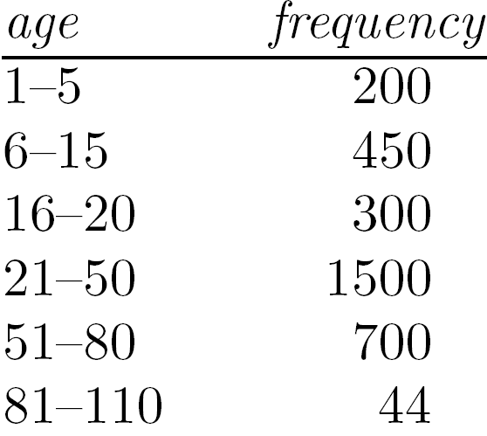
Measuring the Central Tendency
Mean (algebraic measure) (sample vs. population):
Note: n is sample size and N is population size.
Weighted arithmetic mean:
Trimmed mean: chopping extreme values
Median:
Middle value if odd number of values, or average of the middle two values otherwise
Estimated by interpolation (for grouped data):
Mode
Value that occurs most frequently in the data
Unimodal, bimodal, trimodal
Empirical formula:

Slide 13
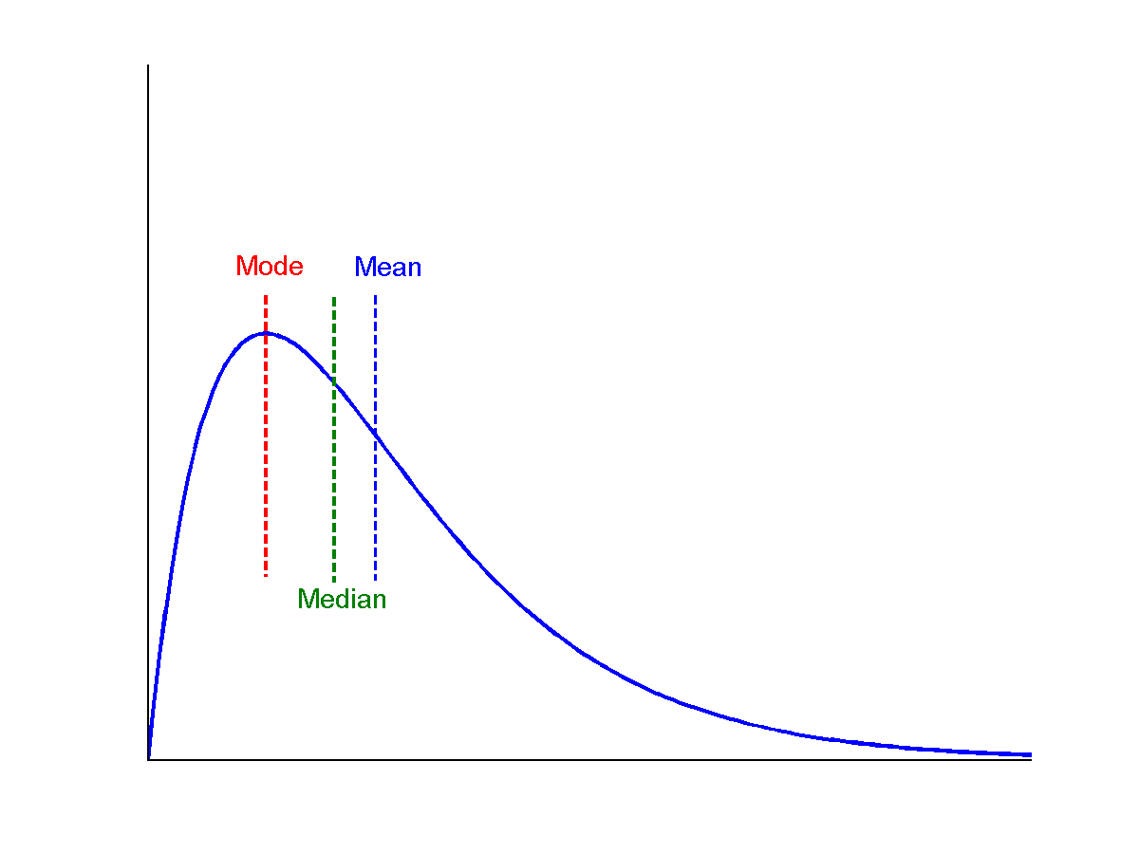
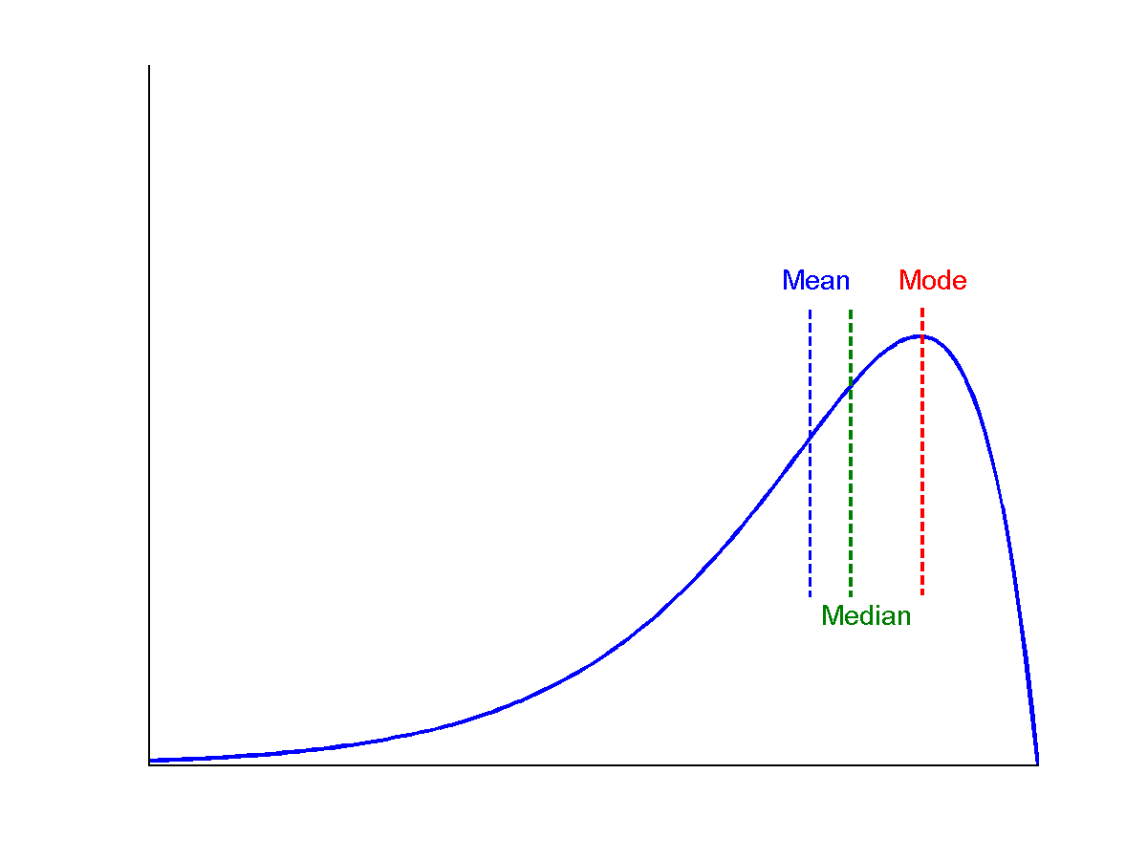
Symmetric vs. Skewed Data
Median, mean and mode of symmetric, positively and negatively skewed data
positively skewed
negatively skewed
symmetric

Slide 14
Measuring the Dispersion of Data
Quartiles, outliers and boxplots
Quartiles: Q₁ (25th percentile), Q₃ (75th percentile)
Inter-quartile range: IQR = Q₃ – Q₁
Five number summary: min, Q₁, median, Q₃, max
Boxplot: ends of the box are the quartiles; median is marked; add whiskers, and plot outliers individually
Outlier: usually, a value higher/lower than 1.5 x IQR
Variance and standard deviation (sample: s, population: σ)
Variance: (algebraic, scalable computation)
Standard deviation s (or σ) is the square root of variance s² ⁽or σ²⁾

Slide 15
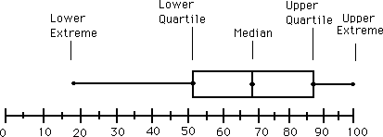
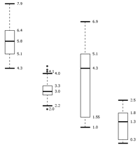
Boxplot Analysis
Five-number summary of a distribution
Minimum, Q1, Median, Q3, Maximum
Boxplot
Data is represented with a box
The ends of the box are at the first and third quartiles, i.e., the height of the box is IQR
The median is marked by a line within the box
Whiskers: two lines outside the box extended to Minimum and Maximum
Outliers: points beyond a specified outlier threshold, plotted individually

Slide 16
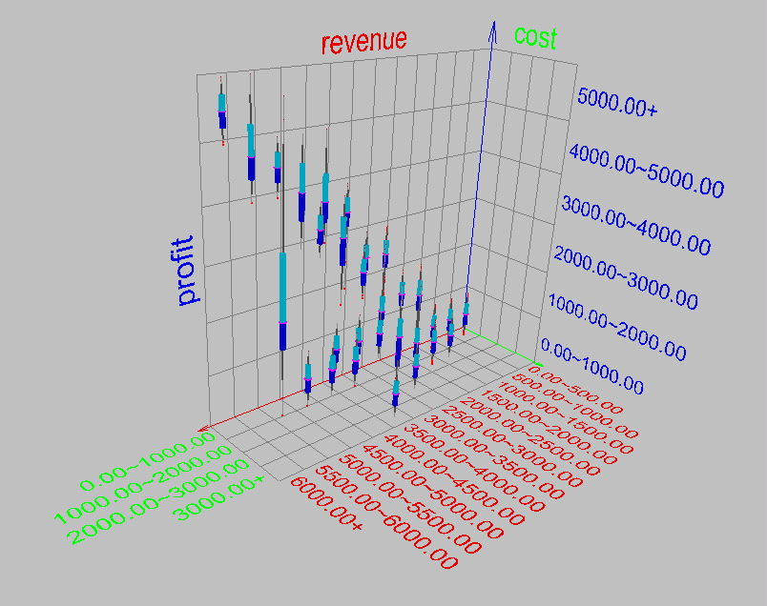
Visualization of Data Dispersion: 3-D Boxplots

Slide 17
Properties of Normal Distribution Curve
The normal (distribution) curve
From μ–σ to μ+σ: contains about 68% of the measurements (μ: mean, σ: standard deviation)
From μ–2σ to μ+2σ: contains about 95% of it
From μ–3σ to μ+3σ: contains about 99.7% of it

Slide 18
Graphic Displays of Basic Statistical Descriptions
Boxplot: graphic display of five-number summary
Histogram: x-axis are values, y-axis repres. frequencies
Quantile plot: each value x_{i} is paired with f_{i} indicating that approximately 100 f_{i} % of data are ≤ x_{i}
Quantile-quantile (q-q) plot: graphs the quantiles of one univariant distribution against the corresponding quantiles of another
Scatter plot: each pair of values is a pair of coordinates and plotted as points in the plane

Slide 19
Histogram Analysis
Histogram: Graph display of tabulated frequencies, shown as bars
It shows what proportion of cases fall into each of several categories
Differs from a bar chart in that it is the area of the bar that denotes the value, not the height as in bar charts, a crucial distinction when the categories are not of uniform width
The categories are usually specified as non-overlapping intervals of some variable. The categories (bars) must be adjacent

Slide 20
Histograms Often Tell More than Boxplots
The two histograms shown in the left may have the same boxplot representation
The same values for: min, Q1, median, Q3, max
But they have rather different data distributions

Slide 21
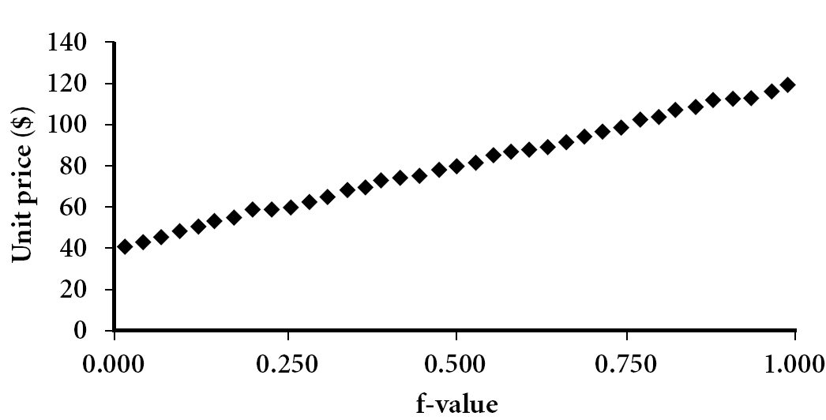
Quantile Plot
Displays all of the data (allowing the user to assess both the overall behavior and unusual occurrences)
Plots quantile information
For a data x_{i} data sorted in increasing order, f_{i} indicates that approximately 100 f_{i}% of the data are below or equal to the value x_{i}

Slide 22
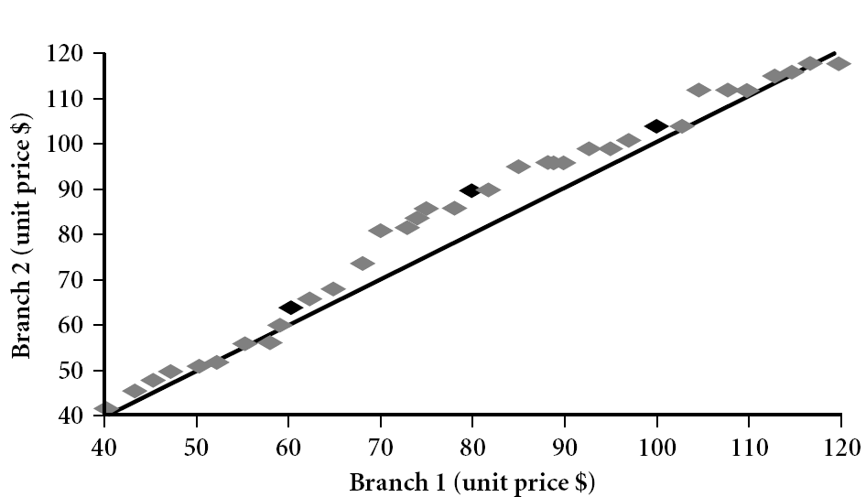
Quantile-Quantile (Q-Q) Plot
Graphs the quantiles of one univariate distribution against the corresponding quantiles of another
View: Is there is a shift in going from one distribution to another?
Example shows unit price of items sold at Branch 1 vs. Branch 2 for each quantile. Unit prices of items sold at Branch 1 tend to be lower than those at Branch 2.
Notes:
Note: We need to label the dark plotted points as Q1, Median, Q3 – that would help in understanding this graph.
Tell audience: There is a shift in distribution of branch 1 WRT branch 2 in that the unit prices of items sold at branch 1 tend to be lower than those at branch 2.

Slide 23
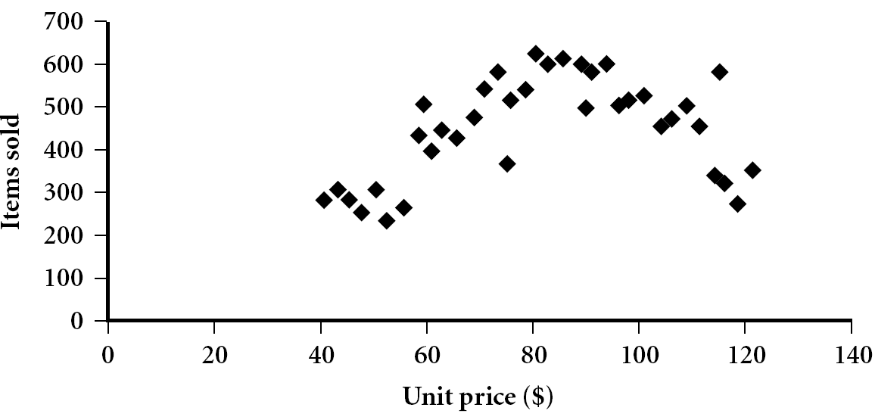
Scatter plot
Provides a first look at bivariate data to see clusters of points, outliers, etc
Each pair of values is treated as a pair of coordinates and plotted as points in the plane

Slide 24
Positively and Negatively Correlated Data
The left half fragment is positively correlated
The right half is negative correlated

Slide 25
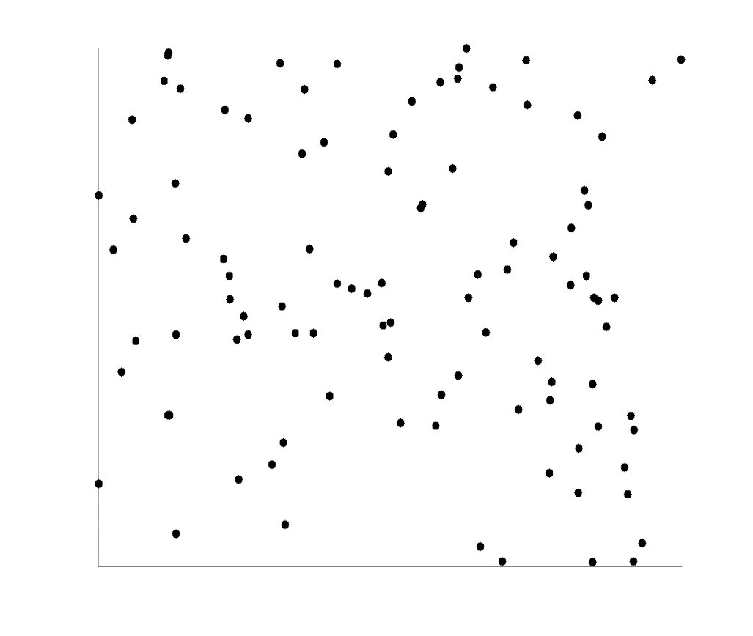
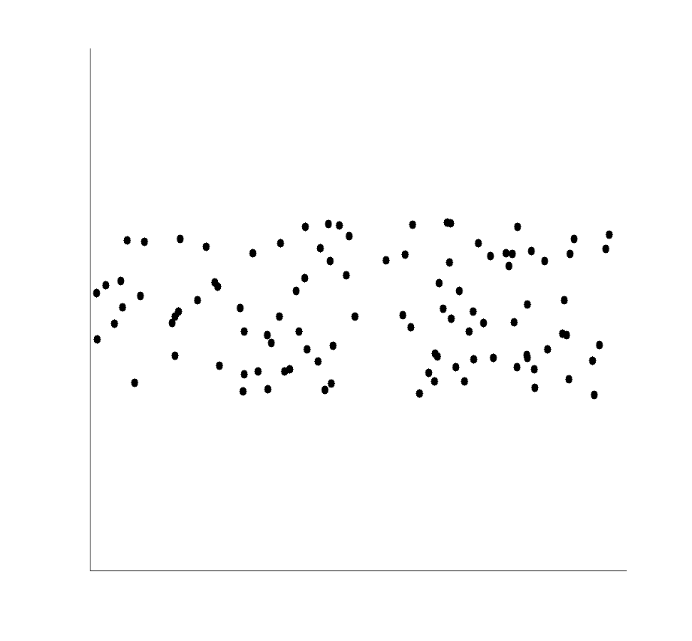
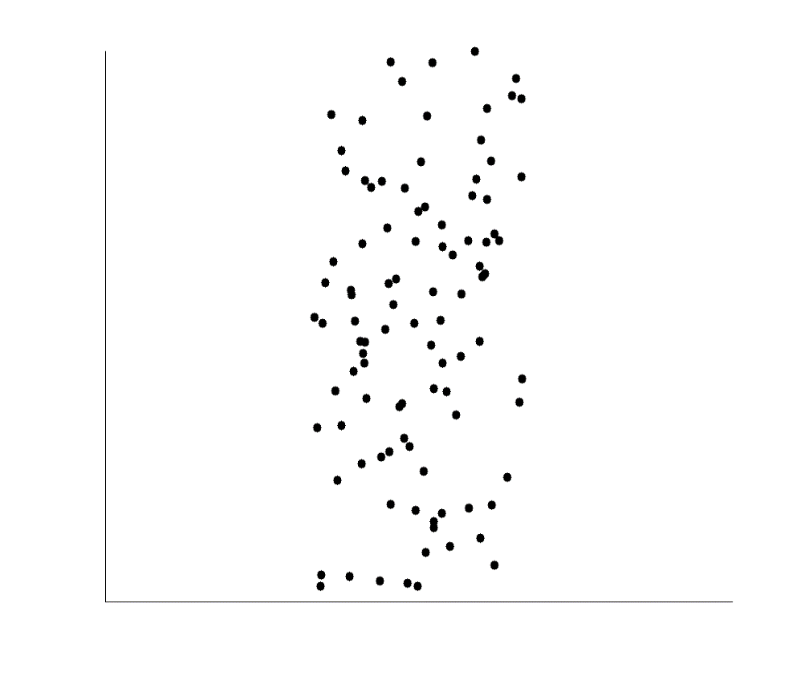
Uncorrelated Data

Slide 26
Summary
Data attribute types: nominal, binary, ordinal, interval-scaled, ratio-scaled
Many types of data sets, e.g., numerical, text, graph, Web, image.
Gain insight into the data by:
Basic statistical data description: central tendency, dispersion, graphical displays
Data visualization: map data onto graphical primitives
Measure data similarity

Slide 27
Reference
a. Essential Reading
1. Class Notes
2. Bramer, M. (2007) Principles of Data Mining. Springer
b. Recommended Reading
1. Torgo, L. (2011) Data Mining with R: Learning with Case Studies. Chapman & Hall
2. Kecman, V. (2001) Learning and Soft Computing. The MIT Press
3. Witten, I. H., Frank, E., and Hall, M. A. (2011) Data Mining: Practical Machine Learning
Tools and Techniques, 3rd edn. Morgan Kaufmann

